Slide 1
Macpherson Family Reunion Photos
25-27 February 2011
Waipapakauri Domain and Houhora Deep Sea Fishing Club, Far North, New Zealand

Slide 2
Adrianna and Kath Brass (Kaitaia) by Nicki Macpherson

Slide 3
Alan Manning (Ngaruawahia), Olive Brooks (Tasmania) Reynold Macpherson (Rotorua) and Ruth Manning (Ngaruawahia) by Sonia Neho

Slide 4
Angela Alldread (Whangarei) and Kirsty Macpherson (Brisbane) by Nicki Macpherson

Slide 5
Angela and Eva Alldread by Robin Dunn

Slide 6
Arlie and Betty McPherson (Auckland) by Natalie McPherson

Slide 7
Arlie McPherson holds the last jar of his father Alec’s red wine, by Natalie McPherson

Slide 8
Arlie McPherson salutes family, by Natalie McPherson

Slide 9
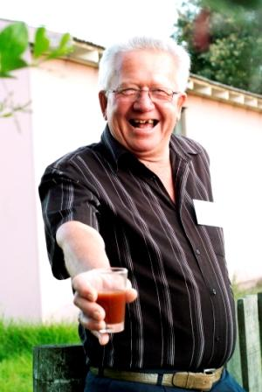
Arlie McPherson offers his father's wine, by Natalie McPherson

Slide 10
Austin Brooks (Tasmania) by Jan Hoskin

Slide 11
Jemma Sayles (Kaitaia) and Austin Brooks (Tasmania) watching Lily Hoskin (Christchurch), by Natalie McPherson

Slide 12
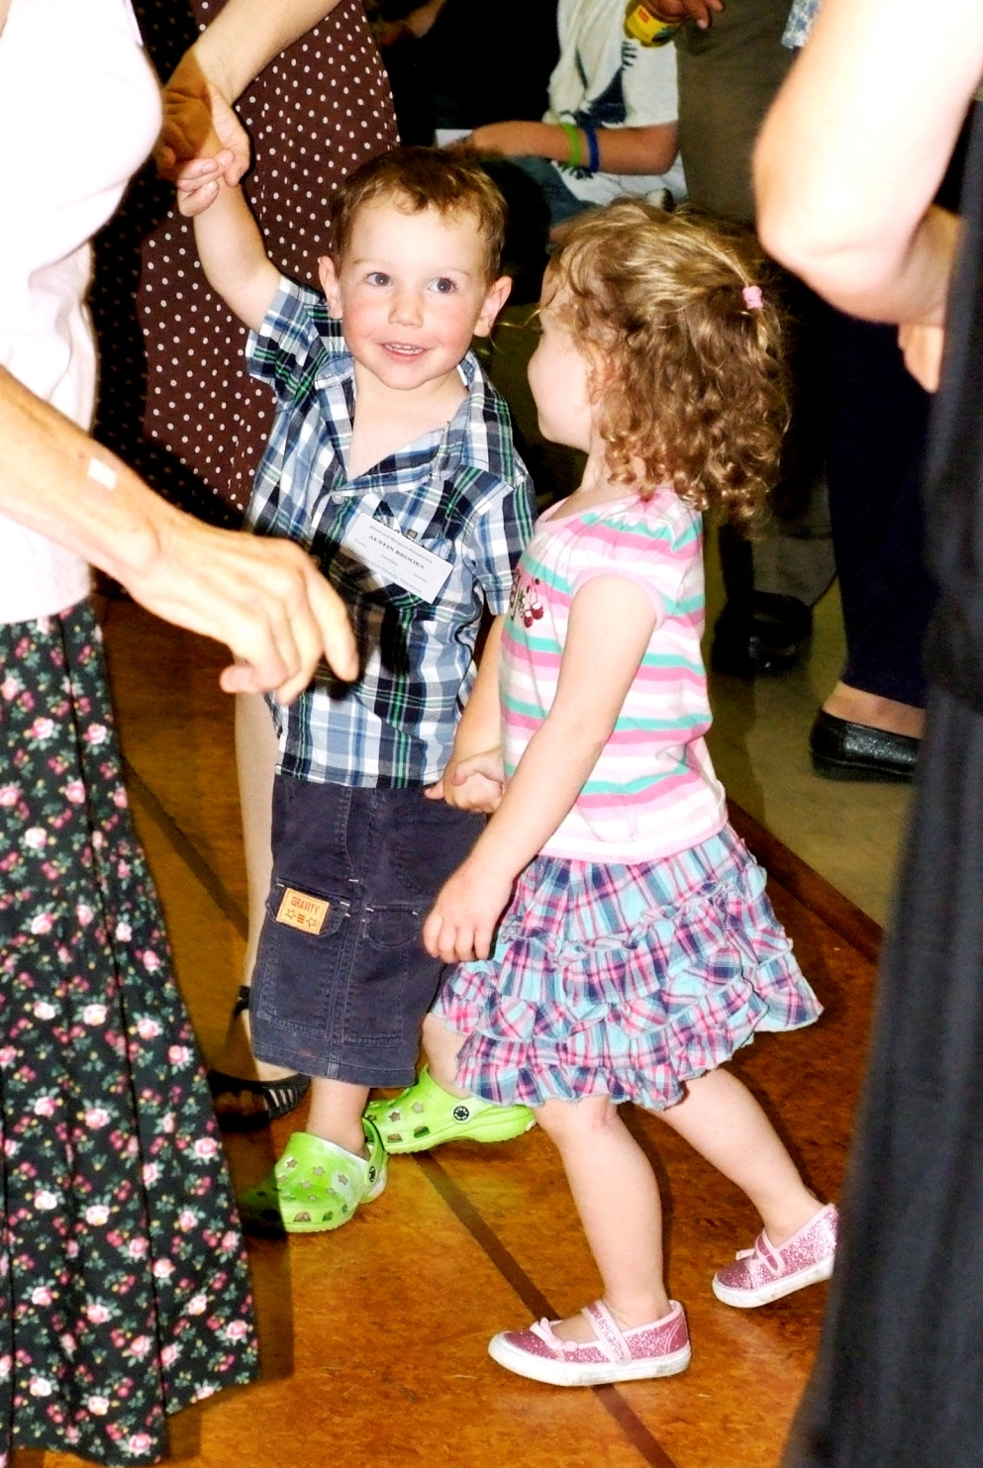
Austin Brooks (Tasmania) and Lily Hoskin (Christchurch) learning ceilidh dancing, by Natalie McPherson

Slide 13
Austin and Shiona Brooks (Tasmania) Nicki and Reynold Macpherson (Rotorua) and Kirsty Macpherson (Brisbane) by Robin Dunn

Slide 14
Damien, Austin, Shiona and Olive Brooks (Tasmania), Angus Macpherson (Brisbane) Nicki and Reynold Macpherson (Rotorua) and Kirsty Macpherson (Brisbane) by Robin Dunn

Slide 15
Damien and Austin Brooks (Tasmania) and Marcia Eastwood (Kaitaia), by Natalie McPherson

Slide 16
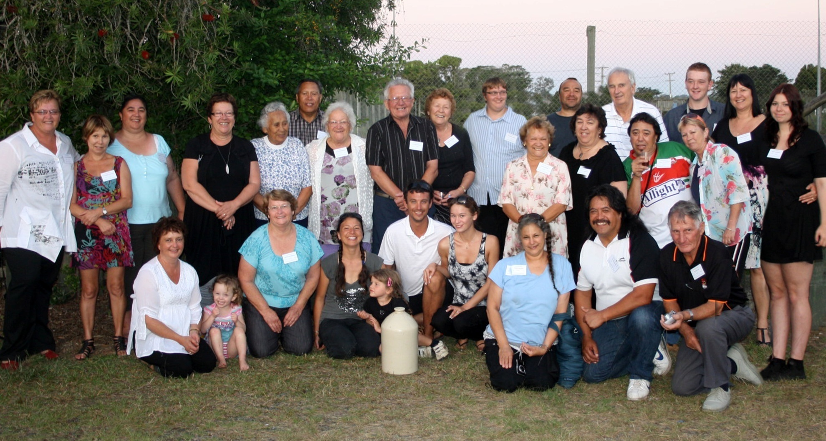
Descendents of Frank and Butu McPherson by Natalie McPherson and Greta Andrews. From the Left Back Row: Natalie McPherson, Jan-Maree Yelavich, Christine McPherson, Paulene McPherson, Mary Tepania, Terry Tepania, Betty McPherson, Arlie McPherson, Ethel Yelavich, Spencer Castle, Mark McPherson, Bob Yelavich, Mitchell Castle, Robynne Andrews and Greta Andrews. Middle Row from Left: Bela MacNee , Marilyn McPherson, Eddy McPherson and his wife. Front Row from Left (all sitting or kneeling): Jan Dixon, Lily Hoskin, Raewyn McPherson, Dana McPherson and her daughter, Joshua McPherson and his fianceé Renee Nichols, Moana McNee, Charlie Hohaia and Ian MacNee.

Slide 17
Doris Andrews and Ken Macpherson by Judi Rogers

Slide 18
Eddie Tepania and Charlie Hohaia (Kaitaia) by Nicki Macpherson

Slide 19
Emma Brass (Kaitaia) by Nicki Macpherson

Slide 20
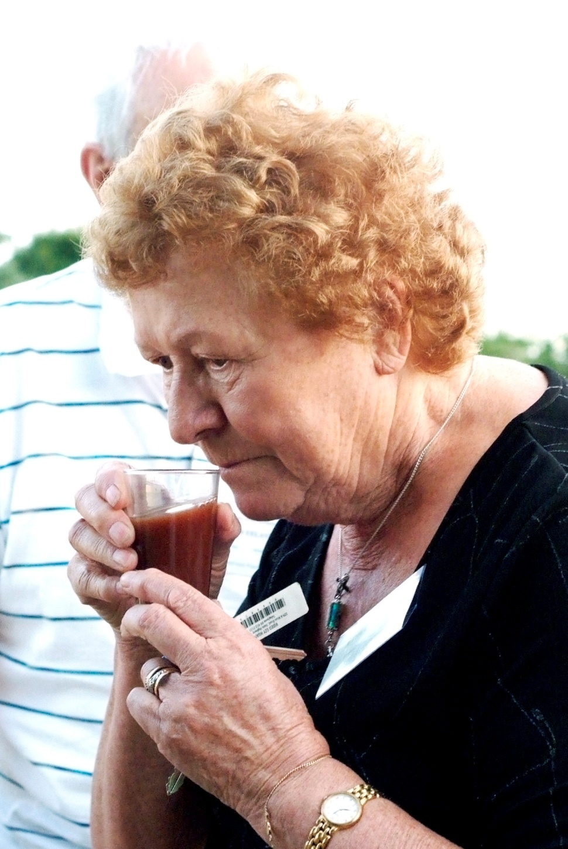
Ethel Yelavich (Auckland) remembers her father Alec’s winemaking, by Natalie McPherson

Slide 21
Eva Alldread by Robin Dunn

Slide 22
Eva Alldread having her face painted by Marcia Eastwood, by Robin Dunn

Slide 23
Eva Alldread and Robin Dunn, by Angela Alldread

Slide 24
Johnny and Meg Matthews (Ahipara) by Nicki Macpherson

Slide 25
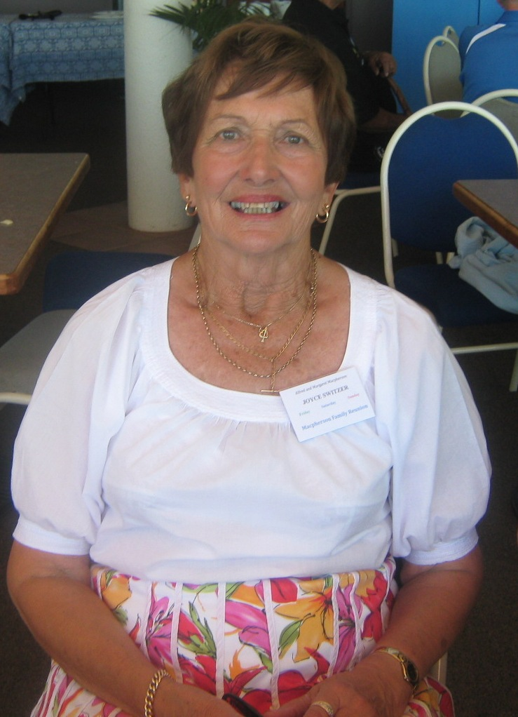
Joyce Switzer (Kaitaia) by Nicki Macpherson

Slide 26
Kath and Ian McNee (Kaitaia) and Kaumatua Pa Moses (Waipapakauri) by Nicki Macpherson

Slide 27
Kath MacNee (Kaitaia) Arlie and Betty McPherson (Auckland), by Natalie McPherson

Slide 28
Kath McNee and Sonia Neho (Kaitaia) with Moana McNee (Auckland) by Eric Neho

Slide 29
Ken and Pat Macpherson (Kaitaia), by Nicki Macpherson

Slide 30
Kylie Yates and Gemma Sayles (Kaitaia) by Nicki Macpherson

Slide 31
Leanne Van Der Sluis, Hunter and Sydney Poore (Auckland) by Nicki Macpherson

Slide 32
Mark Kitchen and Patricia Fraser (Whangarei) by Nicki Macpherson

Slide 33
Michael Van Der Sluis (Auckland) by Nicki Macpherson

Slide 34
Micheal Tepania, Ethel Yelavich, Bub Busby, Kath and Ian MacNee by Sonia Neho

Slide 35
Neta, Joyce, Meg and Patsy neé Macphersons (Kaitaia) by Sonia Neho

Slide 36
Nicki and Reynold Macpherson (Rotorua) and Kirsty Macpherson (Brisbane) by Robin Dunn

Slide 37
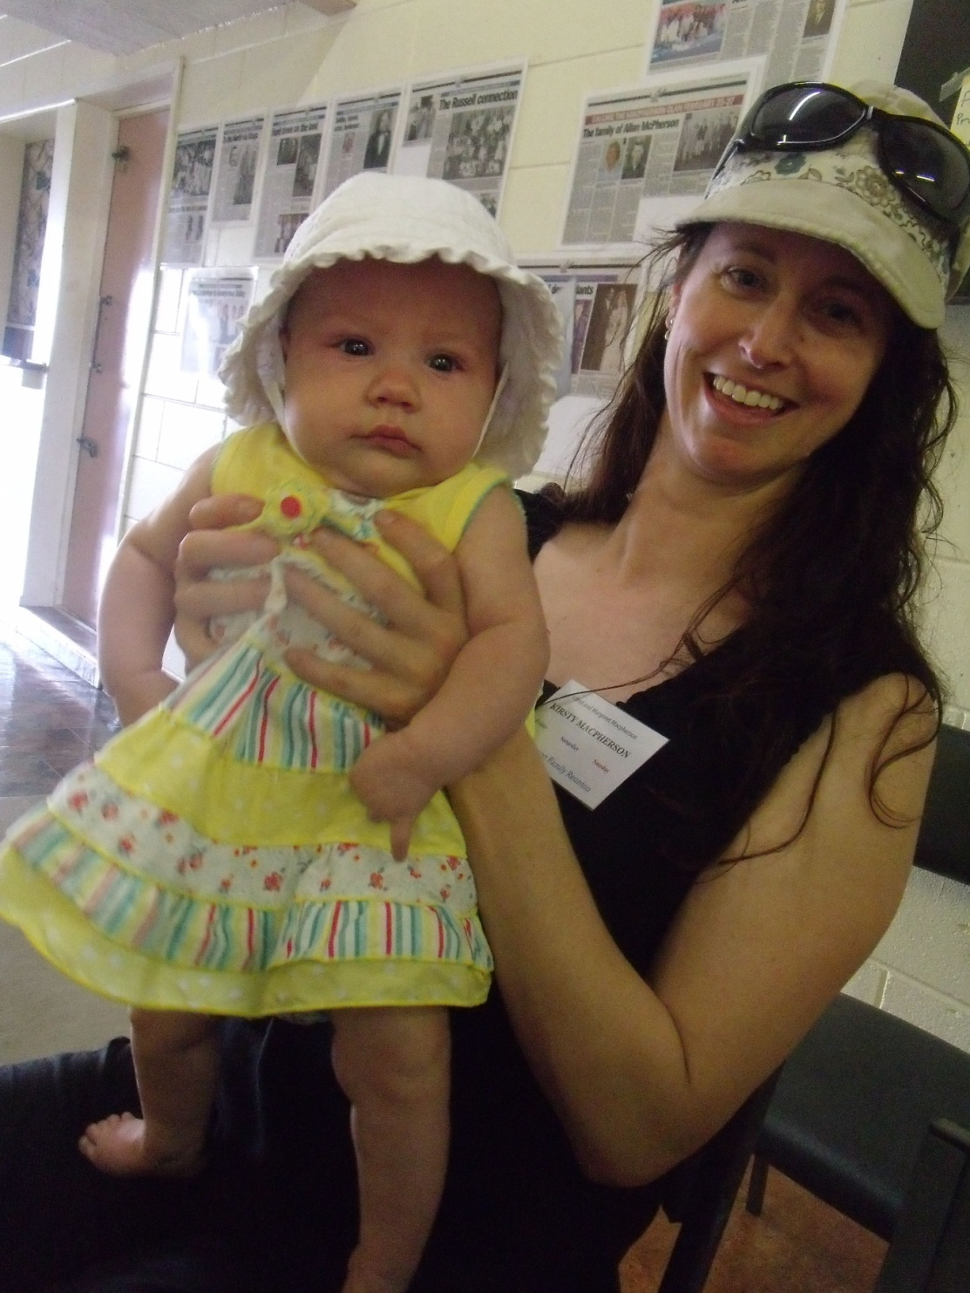
Olive Brooks (Tasmania) and Kirsty Macpherson (Brisbane), by Nicki Macpherson

Slide 38
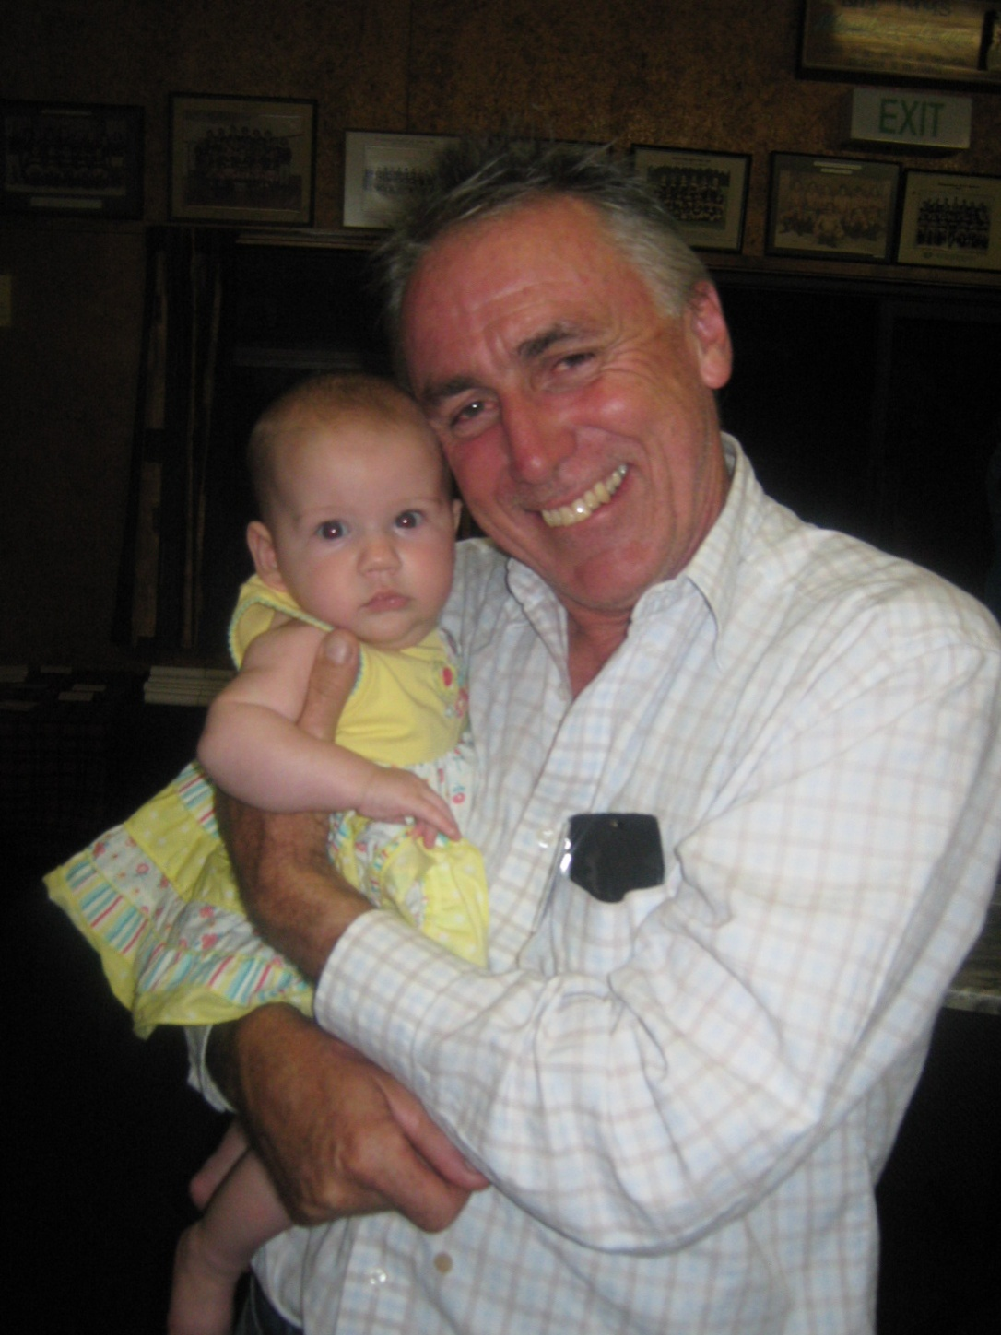
Olive Brooks (Tasmania) and Stuart Macpherson (Sydney), by Nicki Macpherson

Slide 39
Pat and Ken Macpherson (Kaitaia) and Meg Matthews (Ahipara), by Robin Dunn

Slide 40
Patsy White (Cable Bay), by Nicki Macpherson

Slide 41
Pauline Waiti (Wellington), Joshua McPherson, Marilyn Brewin, Renee Nichols (Raewyn and Natalie McPherson in the background) (Auckland) by Sonia Neho

Slide 42
Robin Dunn and Max Alldread (Whangarei), by Nicki Macpherson

Slide 43
Shane Van Der Sluis (Auckland) with Patricia Fraser and Mark Kitchen (Whangarei) by Robin Dunn

Slide 44
Shane Van Der Sluis (Auckland), Patricia Fraser and Mark Kitchen (Whangarei) with Patsy White and Joyce Switzer (Kaitaia), by Natalie McPherson

Slide 45
Sonia Neho and Thomas Busby (Kaitaia), by Nicki Macpherson

Slide 46
Stacey Kitchen (Whangarei) and Brimley Wilson (Auckland), by Nicki Macpherson

Slide 47
Terry Tepania (Kaitaia) Jan Dixon (Christchurch) and Moana McNee (Auckland), by Sonia Neho

Slide 48
Tonya Poore and Jenny Gray (Auckland) by Nicki Macpherson

Slide 49
Willy and Neta Van Der Sluis (Houhora), by Nicki Macpherson

